Slide 1

Diabetes Classification
CS 513 C - Knowledge Discovery & Data Mining
Group #2
Milan Chandiramani,
Suraj Gangwani,
Lilli Nappi,
Komal Wavhal

Slide 2

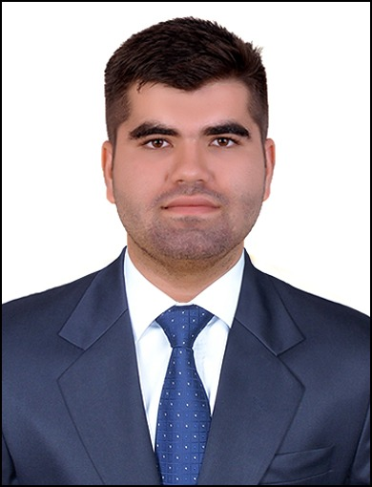



Team Members
Milan G Chandiramani
CWID: 20032010
Suraj Gangwani
CWID: 20031820
Lilli Nappi
CWID: 20006502
Komal Wavhal
CWID: 20034443

Slide 3
Agenda
 |  | 1. | Introduction & Problem Statement
 |  | 2. | Project Process Flow
 |  | 3. | Dataset Review, Data Cleaning & Pre-processing
 |  | 4. | Exploratory Data Analysis
 |  | 5. | Model Overview
 |  | 6. | Comparison & Conclusion
 |  | 7. | Future Work
 |  | 8. | References
 |  | 9. | Q&As

Slide 4

Introduction & Problem Statement
Problem Statement: Diabetes, a prevalent chronic disease, affects millions of people worldwide and is linked to severe complications such as heart disease, vision loss, and kidney failure. Early detection of diabetes can significantly improve treatment outcomes and reduce healthcare costs. This problem can be addressed by developing predictive models to identify individuals at risk of developing diabetes or prediabetes.
Goal: To create a Classification machine learning model that can accurately classify individuals into 2 categories:
Those at risk of diabetes (Prediabetes or diabetes) &
Those who are not at the risk of diabetes
Such models would support early diagnosis, allowing for timely interventions to manage and potentially prevent the disease.
Dataset:
The dataset from the CDC’s Behavioral Risk Factor Surveillance System (BRFSS) for 2015 contains responses from 70,692 individuals, equally split between those with diabetes or prediabetes (class 1) and those without (class 0).
The dataset includes 21 feature variables related to health behaviors and conditions, providing an opportunity to build a classification model to predict diabetes risk.
Link: https://www.kaggle.com/datasets/alexteboul/diabetes-health-indicators-dataset/data

Slide 5




Project Process Flow
Model Selections
Problem Defination
Data Load
Data Cleaning & Pre-processing
Exploratory Data Analysis
Model Training
Model Prediction
Future Scope
Model Deployment
Hyperparameter Tuning
Model Evaluation

Slide 6
Dataset Review
# | Column_Names | Values & Description
1 | Diabetes_binary | Ever told you have Diabetes? 0 = No; 1 = Yes Prediabtes or Diabetes
2 | HighBP | 0 = No High Blood Pressure; 1 = High Blood Pressure
3 | HighChol | 0 = No High Cholesterol; 1 = High Cholesterol
4 | CholCheck | 0 = No Cholesterol Check in 5 years; 1 = Yes Cholesterol Check in 5 years
5 | BMI | Body Mass Index
6 | Smoker | Have smoked 100 cigarettes in entire life? 0 = No 1 = Yes
7 | Stroke | Ever Told You Had a Stroke? 0 = No 1 = Yes
8 | HeartDiseaseorAttack | Have ever had a heart disease or heart attack? 0 = No 1 = Yes
9 | PhysActivity | Physical Activity in Past 30 Days (not including job) 0 = No 1 = Yes
10 | Fruits | Consumed Fruit 1 or More Times Per Day 0 = No 1 = Yes
11 | Veggies | Consumed Vegetables 1 or More Times Per Day 0 = No 1 = Yes
12 | HvyAlcoholConsump | Adult Men >= 14 drinks per week Adult Women >= 7 drinks per week 0 = No 1 = Yes
13 | AnyHealthcare | Have any kind of healthcare coverage? 0 = No 1 = Yes
# | Column_Names | Values & Description
15 | NoDocbcCost | Any time in past 12 months needed a doctor but could not go because of cost? 0 = No 1 = Yes
16 | GenHlth | Would you say that in general your health is: 1 = Excellent 2 = Very Good 3 = Good 4 = Fair 5 = Poor
17 | DiffWalk | Have serious difficulty walking or climbing stairs 0 = No 1 = Yes
18 | Sex | 0 = Female 1 = Male
19 | Age | Scale 1-13 1 = 18-24 Increments every 5 years 13 = 80+
20 | Education | Highest Grade or Year of School Completed 1 = Never Attended / Only Kindergarten 2 = Elementary 3 = Some Highschool 4 = Graduated Highschool 5 = Some College 6 = Graduated College
21 | Income | Scale 1-8 Increment every $5k 1 = less than $10,000 5 = $20,000 - $35,000 8 = $75,000+
22 | MentHlth | Days of Poor Mental Health 1-30 days
23 | PhysHlth | Physical Illness or Injury In Past 30 days 1-30 days

Slide 7
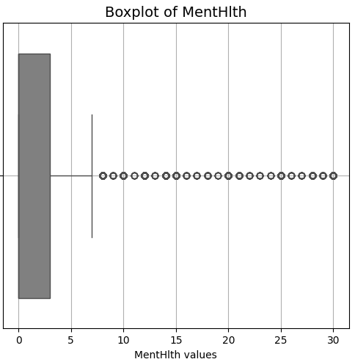
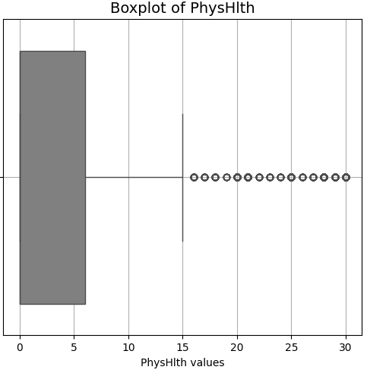
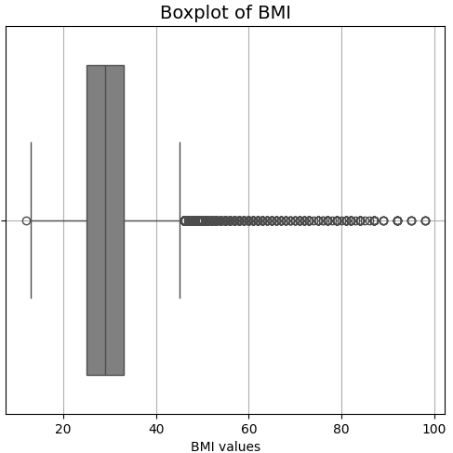
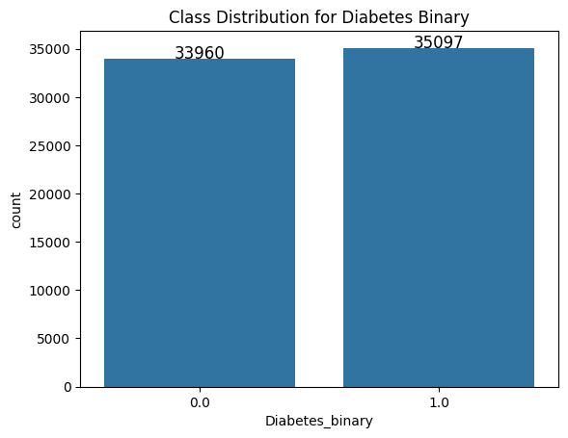
Data Cleaning & Pre-Processing
Missing Values: No missing values observed.
Duplicates: 1635 duplicate records were observed & removed.
Outliers: Based on the Box Plot, outliers were observed for features 'PhysHlth', 'MentHlth', 'BMI’ and were reduced.
Data Type: All were numerical data types (float64) bit. No Categorical data types present.
Feature Scaling: Standard scalar
Balanced Class: the diabetes_binary classes were balanced in nature with very minor difference after removing duplicates and outliers.

Slide 8
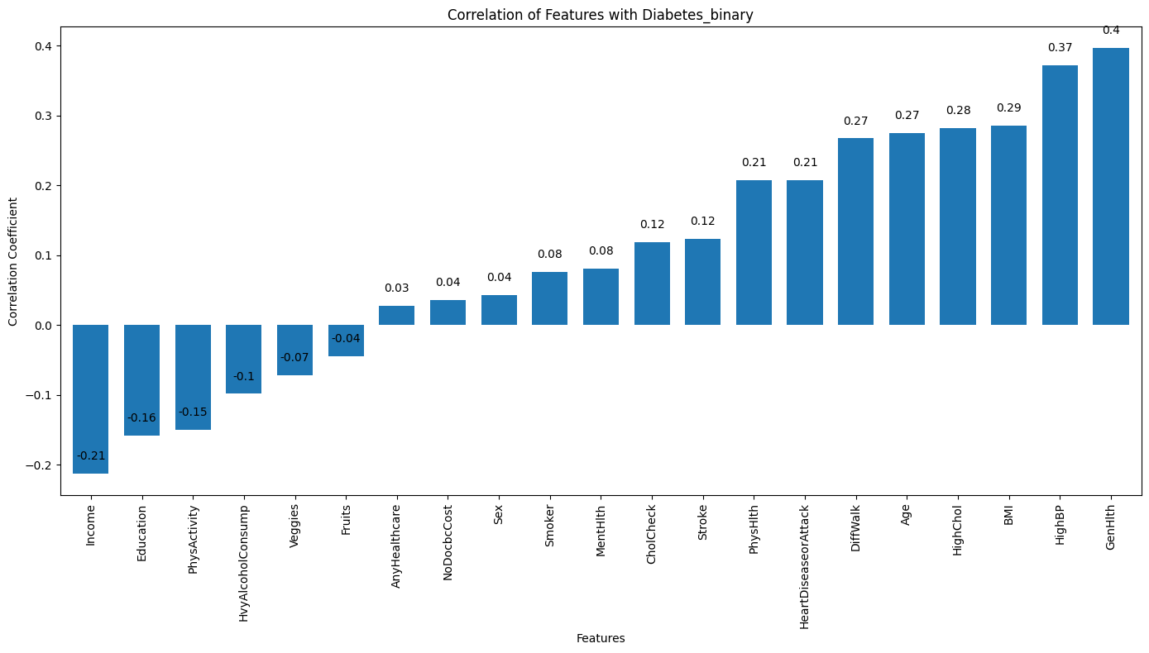
Exploratory Data Analysis (1 of 3)
Correlation Coefficients: The chart displays the correlation coefficient between each input feature and the ‘Diabetes_Binary’ target variable. The correlation coefficient measures the strength and direction of the linear relationship between two variables.
Positive Correlation: Features like ‘Age’, ‘HighChol’, ‘HighBP’, ‘BMI’, and ‘GenHlth’ show a positive correlation with “Diabetes_Binary”. This suggests that as these features increase, the likelihood of having diabetes also tends to increase.
Negative Correlation: Features like ‘Income’, ‘Education’, ‘PhysActivity’, and ‘HvyAlcoholConsump’ exhibit a negative correlation with ‘Diabetes_Binary’.
This implies that individuals with higher income, education, and physical activity levels, and lower heavy alcohol consumption, are less likely to have diabetes.
Weak Correlation: Many features, such as ‘Veggies’, ‘Fruits’, ‘AnyHealthcare’, ‘NoDocbcCost’, ‘Sex’, and ‘Smoker’, show a very weak correlation with ‘Diabetes_Binary’. This indicates that these features might have limited predictive power for diabetes in this dataset
Insights:
Risk Factors: The chart highlights potential risk factors for diabetes, such as older age, high cholesterol, high blood pressure, and poor general health.
Protective Factors: Features like higher income, education, and physical activity appear to be associated with a lower risk of diabetes.
Feature Importance: Features with stronger correlations (positive or negative) are likely to be more important for predicting diabetes in a machine learning model.

Slide 9
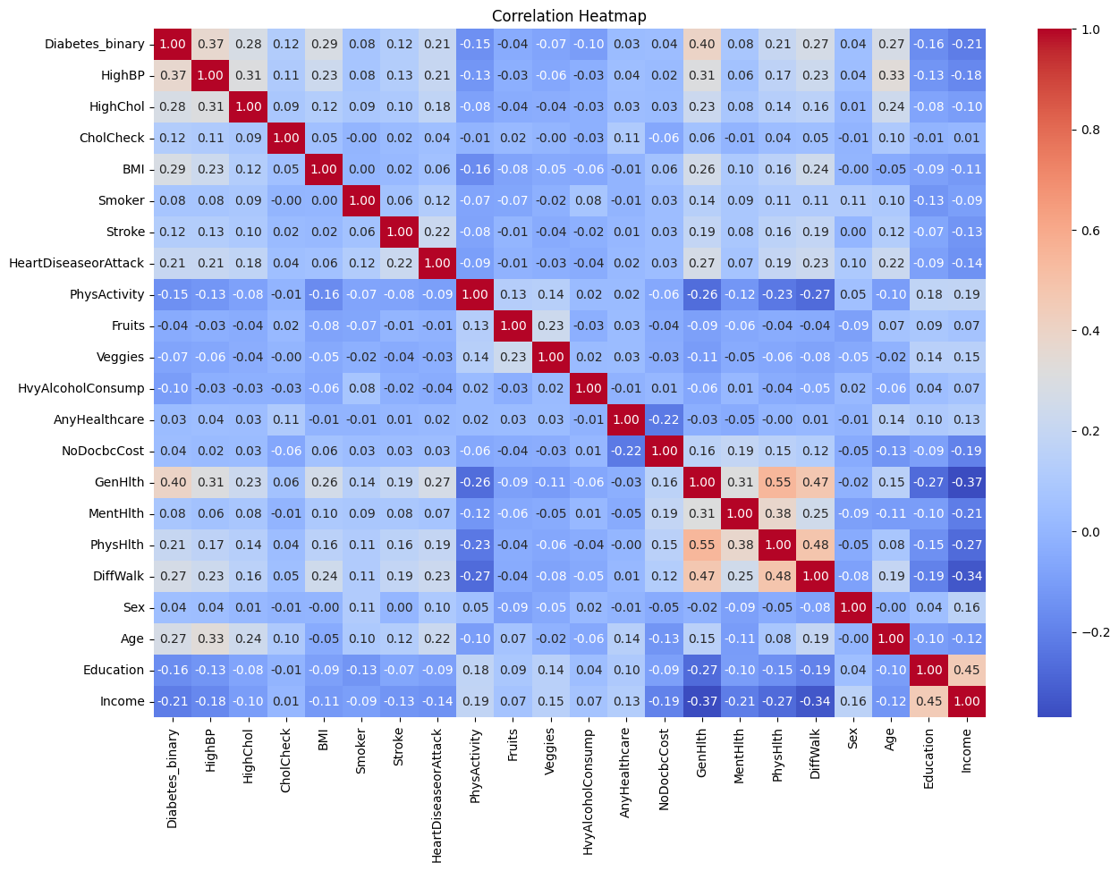
Exploratory Data Analysis (2 of 3)
Strong Positive Correlations with Diabetes_Binary:
BMI: 0.29 - A strong positive correlation indicates that the risk of diabetes increases significantly with increase in BMI.
HighBP (High Blood Pressure): 0.37 - A very strong positive correlation indicates a strong association between high blood pressure and diabetes.
HighChol (High Cholesterol): 0.28 - A moderate positive correlation suggests that high cholesterol is associated with an increased risk of diabetes.
GenHlth (General Health): 0.40 - A strong correlation indicates that individuals with better self-reported general health are less likely to have diabetes.
Moderate Positive Correlations with Diabetes_Binary:
HeartDiseaseorAttack: 0.21 - A moderate positive correlation suggests a link between heart disease and diabetes.
PhysHlth (Physical Health): 0.21 - A moderate positive correlation indicates that individuals with poorer physical health are more likely to have diabetes.
DiffWalk (Difficulty Walking): 0.27 - A moderate positive correlation suggests that difficulty walking is associated with an increased risk of diabetes.
Negative Correlations with Diabetes_Binary:
Education: -0.16 - A negative correlation suggests that higher education is associated with a lower risk of diabetes.
Income: -0.21 - A negative correlation suggests that higher income is associated with a lower risk of diabetes.
PhysActivity (Physical Activity): -0.15 - A negative correlation suggests that individuals who are physically active are less likely to have diabetes.
Other Observations:
CholCheck (Cholesterol Check): A weak correlation (0.12) suggests that the frequency of cholesterol checks might not have a strong direct relationship with diabetes status in this dataset.
Smoking & Alcohol Consumption: The correlations with smoking (0.04) and alcohol consumption (0.01) are very weak, indicating that these factors might not be as strongly associated with diabetes in this dataset compared to other factors.
Correlation Heatmap

Slide 10
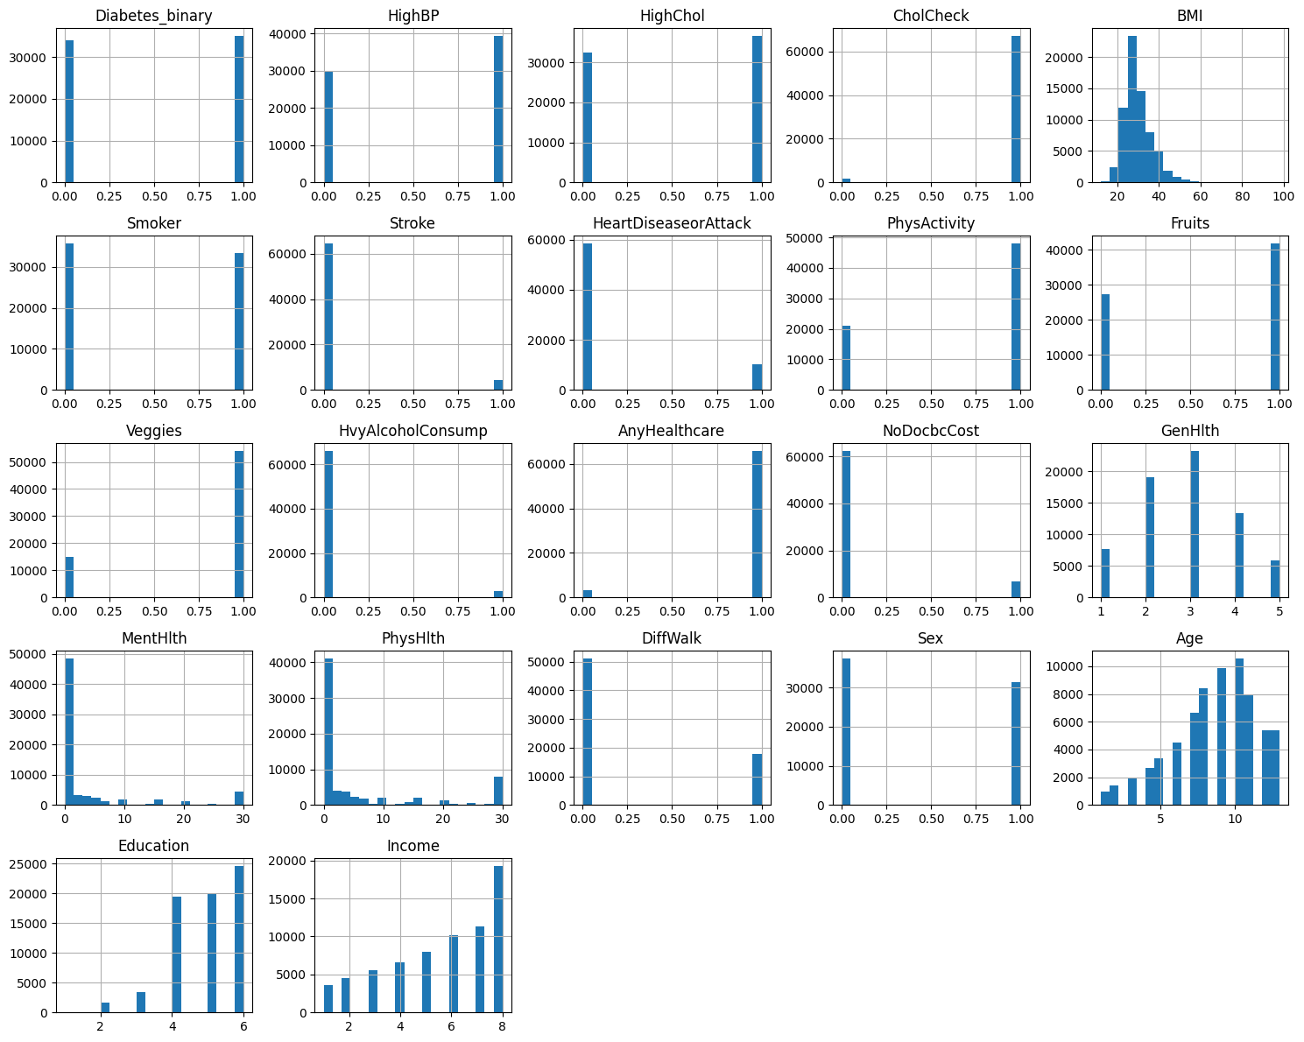
Exploratory Data Analysis (3 of 3)
Based on the histogram analysis, the BMI is left skewed and also has few outliers above 45 plus (as confirmed by Box plot as well)
Diabetes_Binary: This is the target variable. The histogram likely shows an imbalance in the classes (more non-diabetic cases than diabetic cases), which is common in medical datasets. This imbalance needs to be addressed during model training to avoid biased results.
HighBP, HighChol, HeartDiseaseorAttack, Stroke: These features likely show a higher proportion of individuals without these conditions compared to those with.
Feature Types: We can identify the types of features: Binary: Features like Diabetes_Binary, Smoker, Stroke, etc., seem to be binary (0/1) variables.
Ordinal: Features like Education and Income likely represent ordinal categories.
Continuous: Features like Age, BMI, MentHlth, PhysHlth seem to be continuous variables.
Histogram

Slide 11
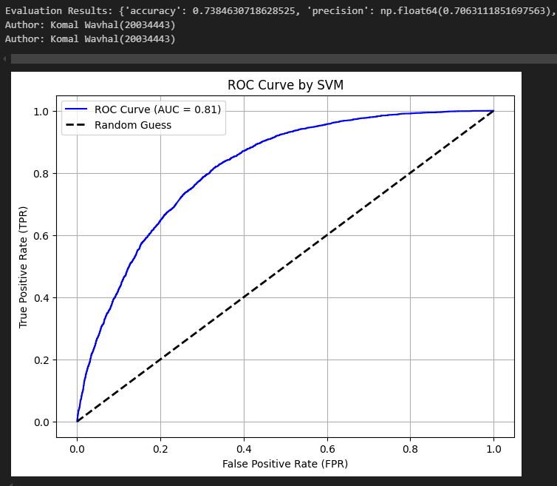
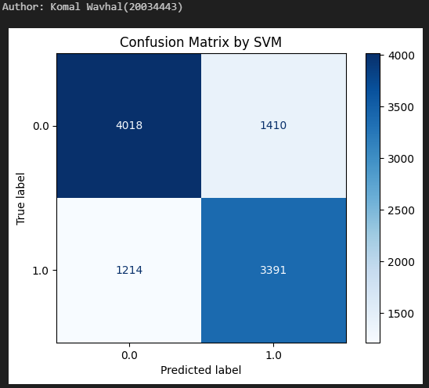
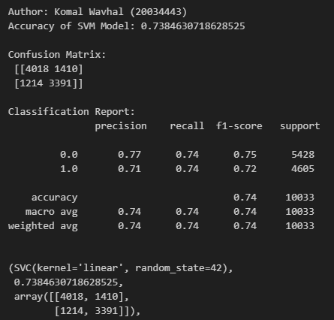
Model Overview (Support Vector Machine)
SVM Model:
The kernel='linear' argument specifies that a linear kernel is used for the SVM. This is suitable for linearly separable data.
probability=True enables the model to estimate class probabilities, which is useful for tasks like calculating AUC.
Performance Metrics:
Accuracy: The proportion of correctly classified instances. In this case, the accuracy is around 0.738, i.e. 73.8%. Is important when classes are balanced and False Positives and False Negatives carry similar consequences.
Precision: Precision measures how many of the instances predicted as positive are actually positive. It's around 0.706 i.e. 70.6% Is important when False Positive is more critical,
Recall: Recall quantifies the proportion of actual positive instances correctly identified by the model. It's around 0.736 i.e. 73.6% Is important when False Negatives are more critical e.g. Medical diagnosis
F1-score: The harmonic mean of precision and recall, providing a balance between the two. It's around 0.721 i.e. 72.1% Is more important when dataset is unbalanced. However, for a nearly balanced data in our project, so, it’s not crucial here.
AUC (Area Under the ROC Curve): A measure of the model's ability to distinguish between positive and negative classes. It's around 0.815 i.e. 81.5%
Conclusion: AUC-ROC evaluates the model across all possible thresholds, providing a more comprehensive view of performance compared to metrics like accuracy, which depend on a specific threshold.
Confusion Matrix:
True Positive (TP): 3391 - The model correctly predicted the positive class (1.0) for 3391 instances.
True Negative (TN): 4018 - The model correctly predicted the negative class (0.0) for 4018 instances.
False Positive (FP): 1410 - The model incorrectly predicted the positive class (1.0) when the actual class was negative (0.0). These are also known as Type I errors.
False Negative (FN): 1214 - The model incorrectly predicted the negative class (0.0) when the actual class was positive (1.0). These are also known as Type II errors.

Slide 12
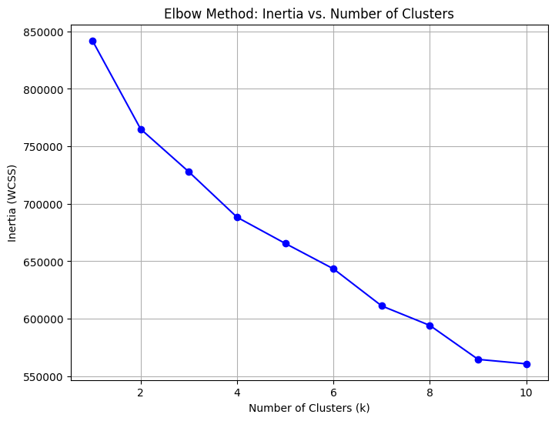
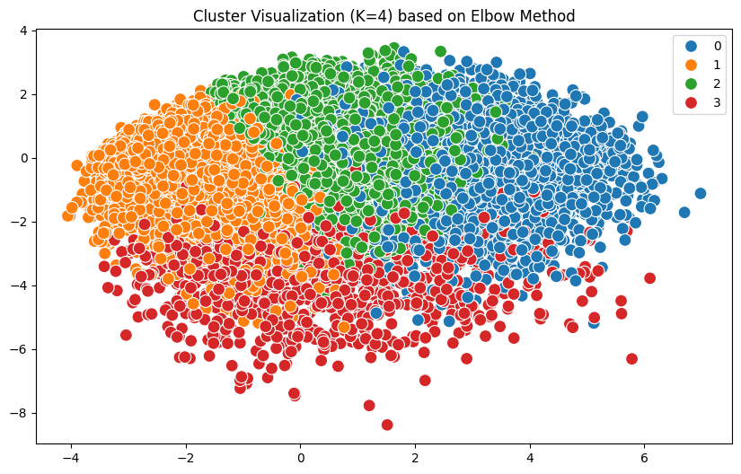
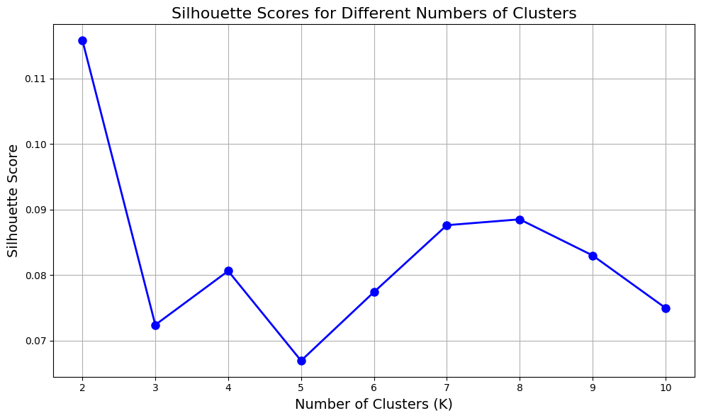
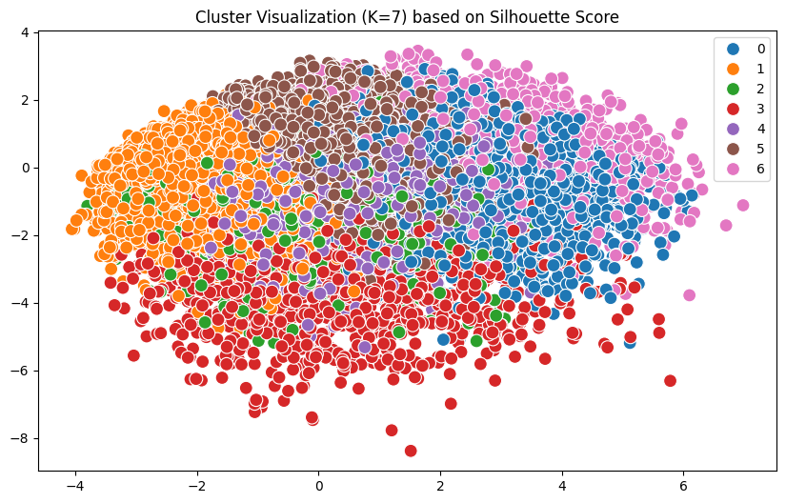
Model Overview (K-Means Clustering)
K-means clustering, an un-supervised algorithm doesn’t work great for irregular shaped clusters as visualized for K=4 and K=7 based on Elbow method and Silhouette Scores resp.
For Elbow method:
After K = 4, the decrease in WCSS i.e. within-cluster sum of squares becomes less pronounced.
For Silhouette Scores:
The highest Silhouette Score appears to be around K=7 clusters where,
a Silhouette Score of 0.09 suggests that the clustering solution is not very strong. The clusters are likely to be weakly separated, and there may be some overlap or ambiguity in how the data is grouped.
Note: There’s no accuracy for K-means as accuracy measures how many predictions match ‘True’ labels and K-means is unsupervised so, No labels.

Slide 13
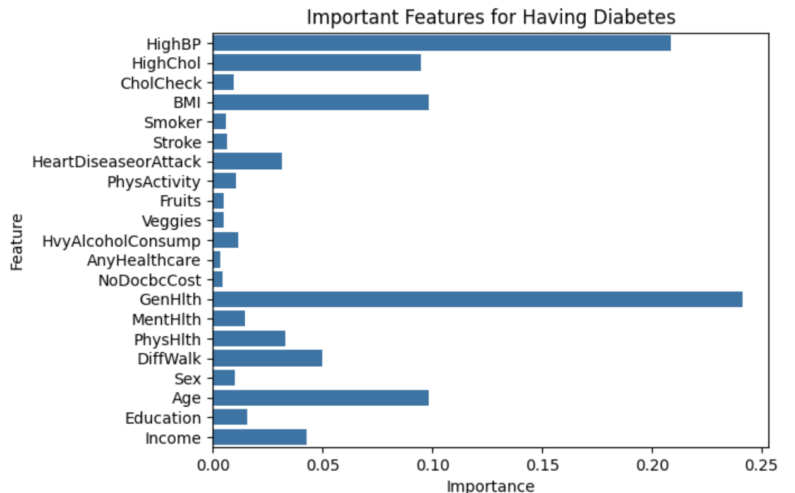
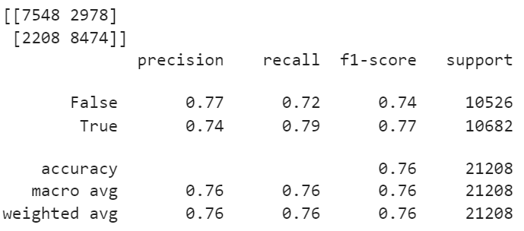
Model Overview – Random Forest
Dataset:
The dataset contained features relevant to diabetes diagnosis and a binary target indicating the presence or absence of diabetes.
Preprocessing:
Categorized BMI 0: <=18, 1: 19-24, 2: 25-29, 3: 30-39, 4: 40+ according to CDC guidelines
Model Evaluation:
Was evaluated with num_estimators=100 and max_depth=10 to shorten computational time and costs
Performance Metrics:
Model performance was evaluated using accuracy score on the test set.
Results
The highest accuracy was achieved at random state=13, with a score of 75.59%
Indicates most important features for having prediabetes or diabetes are: GenHlth, HighBP, Age, BMI, and HighChol

Slide 14
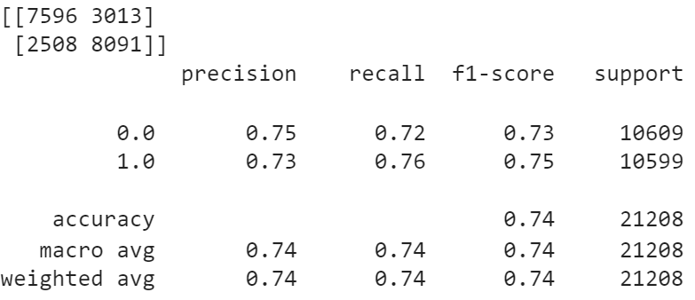
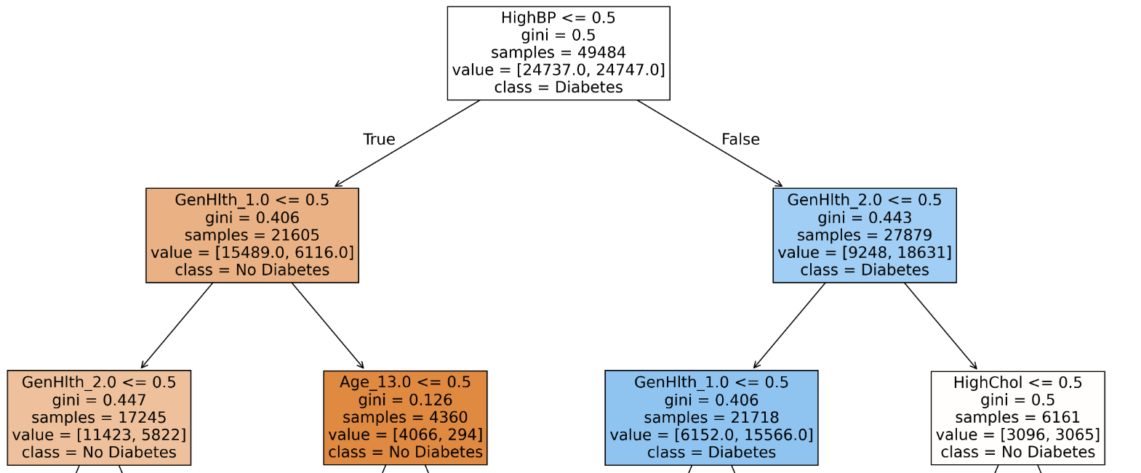
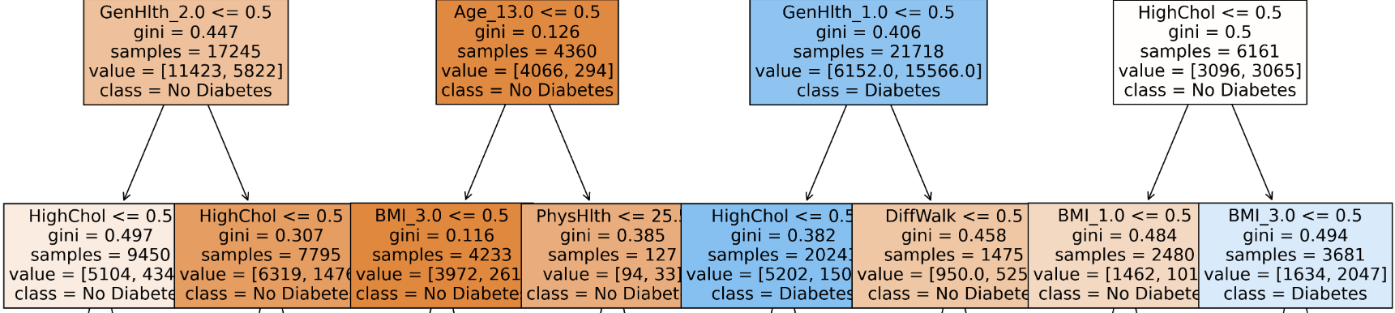
Model Overview – Decision Tree
Dataset:
The dataset contained features relevant to diabetes diagnosis and a binary target indicating the presence or absence of diabetes.
Preprocessing:
Categorized BMI 0: <=18, 1: 19-24, 2: 25-29, 3: 30-39, 4: 40+ according to CDC guidelines
One-hot encoded categorical values GenHlth, Age, Education, BMI and Income
Model Evaluation:
Was evaluated with criterion=gini and max_depth=10 to shorten computational time and costs
Performance Metrics:
Model performance was evaluated with an accuracy score on the test set.
Results
The highest accuracy was achieved at random state=35, with a score of 73.97%
Tree is displayed with a max_depth=3 to focus on top 3 levels which holds the most importance
Tree predicts those who do not have HighBP, likely to also not have diabetes even with low GenHlth, and high Age, BMI and HighChol
While those who do have HighBP are likely to not have Diabetes if low BMI and do not have trouble walking

Slide 15
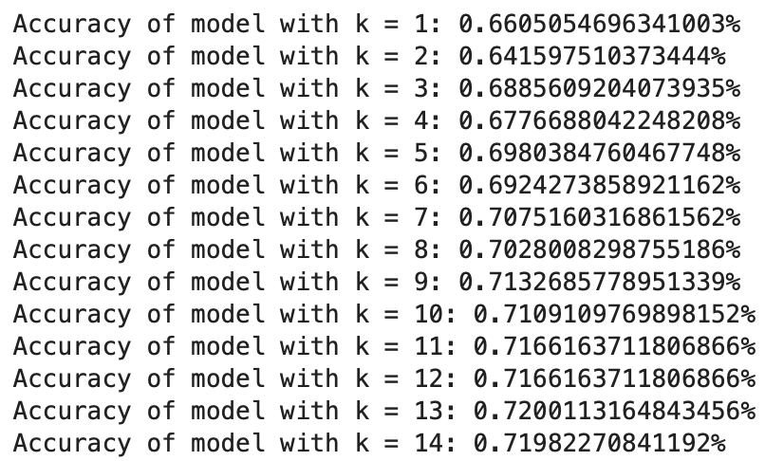
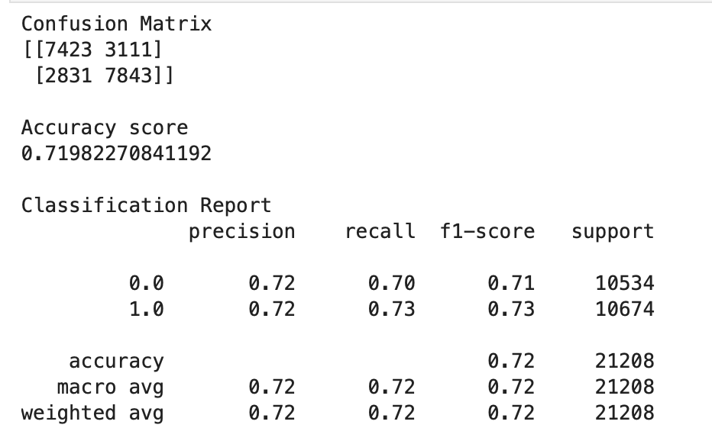
Model Overview – K Nearest Neighbour
Dataset:
The dataset contained features relevant to diabetes diagnosis and a binary target indicating the presence or absence of diabetes.
Model Evaluation:
The KNN algorithm was tested for K values ranging from 1 to 14.
Two distance metrics were used:
Euclidean Distance: Measures straight-line distance between points.
Manhattan Distance: Measures distance as the sum of absolute differences in each dimension.
Performance Metrics:
Model performance was evaluated using accuracy score on the test set.
Results
The highest accuracy was achieved at k=13, with a score of 72%.
Euclidean Distance outperformed Manhattan Distance consistently across all k values.
Performance comparison revealed that Euclidean Distance provided better generalization for this dataset, likely due to its sensitivity to overall feature magnitude.

Slide 16
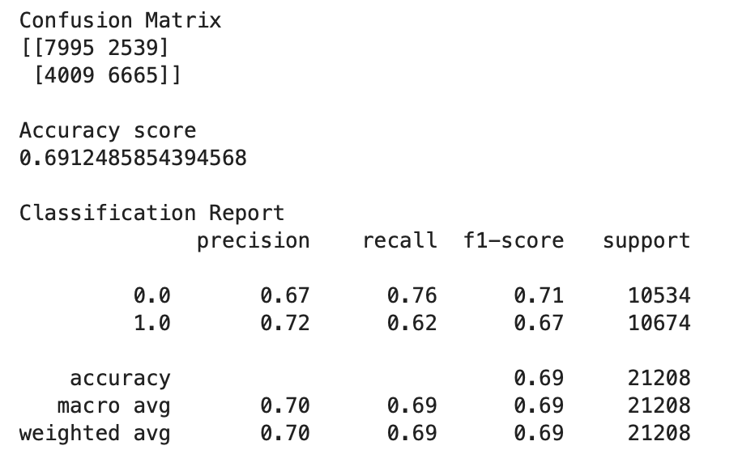
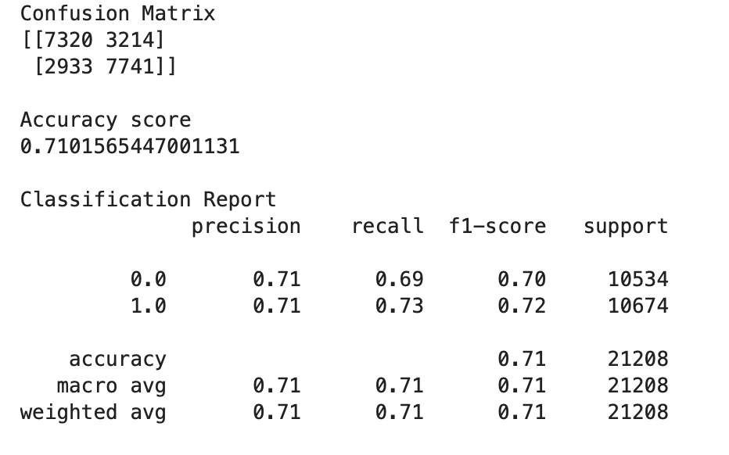
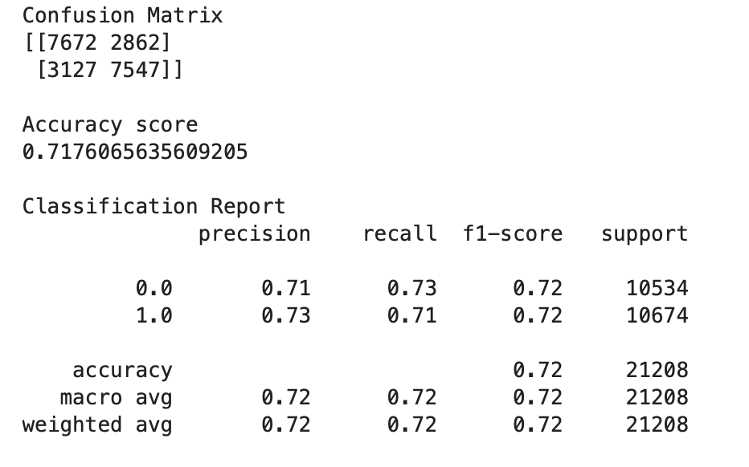
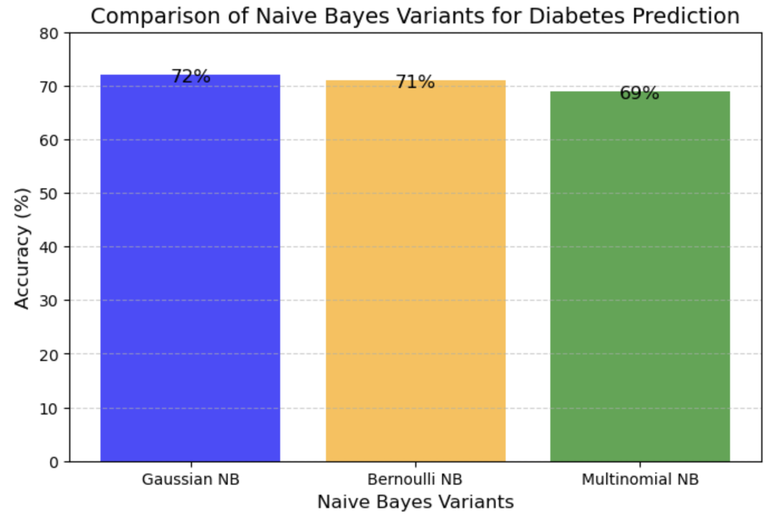
Model Overview - Naïve Bayes
MultiNomial NB
Bernoulli NB
Dataset:
The dataset included features relevant to diabetes diagnosis and a binary target indicating the presence or absence of diabetes.
Appropriate preprocessing was applied, ensuring compatibility with each Naive Bayes variant.
Algorithm Variants:
Gaussian NB: Assumes features are normally distributed.
Multinomial NB: Designed for discrete counts, suitable for text data but adapted for this analysis.
Bernoulli NB: Suitable for binary features, modeling the presence or absence of features.
Model Evaluation:
Each variant was tested using the same dataset and evaluated using accuracy score on the test set.
Results
Gaussian NB: Achieved the highest accuracy of 72%, leveraging its assumption of normally distributed features.
Bernoulli NB: Performed slightly lower at 71%, benefiting from binary feature modeling.
Multinomial NB: Scored 69%, as its assumption of discrete counts was less aligned with the dataset characteristics.
Gaussian NB

Slide 17
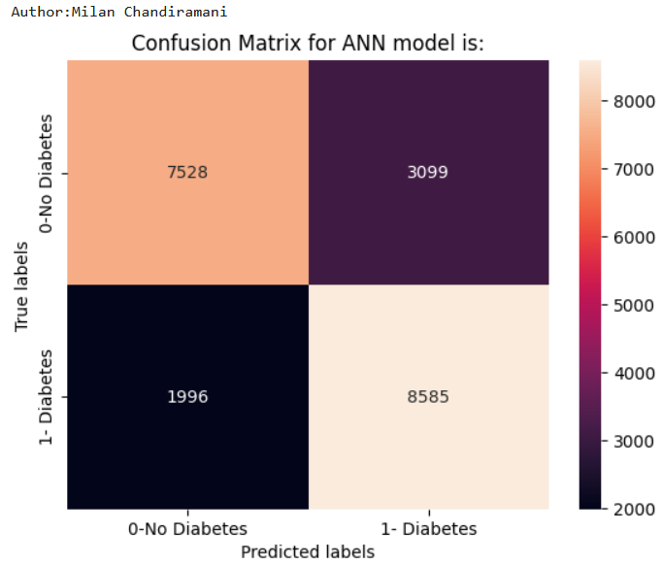
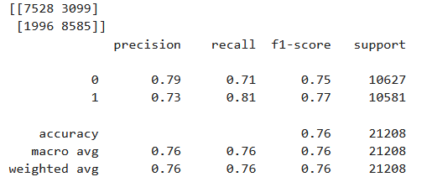
Model Overview – Artificial Neural Network (ANN)
Preprocessing:
Categorized BMI 0: <=18, 1: 19-24, 2: 25-29, 3: 30-39, 4: 40+ according to CDC guidelines
Ensured all considered parameters are encoded using label encoders
Did extensive check by setting up combination of neurons across 2 hidden layers
Model Evaluation:
Best model dependent on accuracy is achieved with 2 hidden layers of 28 and 14 neurons respectively.
Was evaluated with hyperparameters:
dropout_rate = 0.1, epochs = 11
batch_size = 32, learn_rate = 0.001
Performance Metrics:
Model performance was evaluated using accuracy score on the test set.
Results
The highest accuracy was achieved at random state=57, with a score of 75.98%
A high precision of 81% is achieved

Slide 18
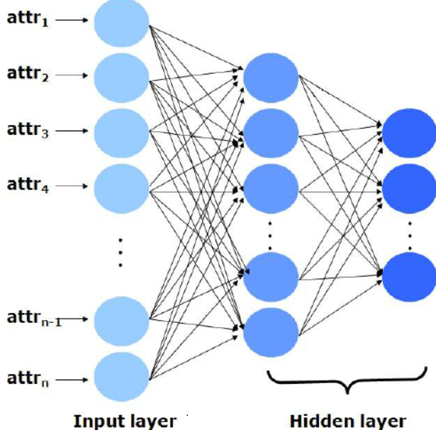
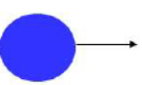

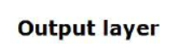
Model Overview – Artificial Neural Network (ANN)
Input Layer:
21 parameters
Hidden Layer 1: 28 neurons
Hidden Layer 2: 14 neurons

Slide 19
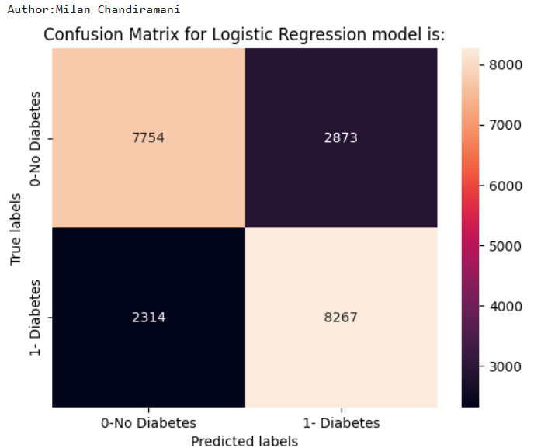
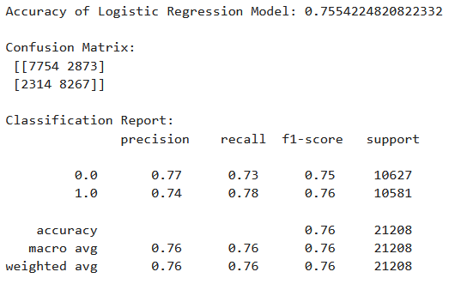
Model Overview – Logistic Regression
About Model
Logistic regression is a supervised machine learning algorithm used for classification tasks where the goal is to predict the probability that an instance belongs to a given class or not.
Model Evaluation:
Binary Classifier
L2 penalty is used for model training and evaluation.
Performance Metrics:
Model performance was evaluated using accuracy score on the test set.
Results
The highest accuracy was achieved at random state=57, with a score of 75.54%

Slide 20
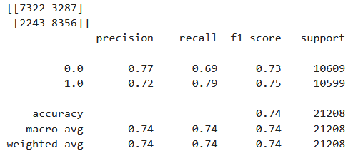
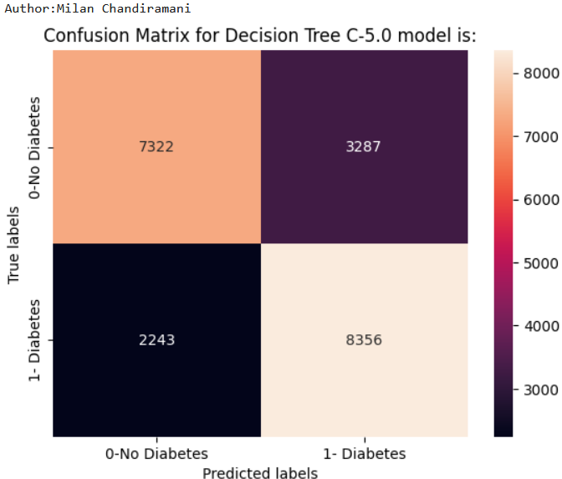
Model Overview – Decision Tree C-5.0
Preprocessing:
Categorized BMI 0: <=18, 1: 19-24, 2: 25-29, 3: 30-39, 4: 40+ according to CDC guidelines
One-hot encoded categorical values General Health, Age, Education, BMI and Income
Top 15 Params: 'HighBP', 'HighChol', 'BMI', 'Smoker', 'Stroke', 'HeartDiseaseorAttack', 'PhysActivity', 'NoDocbcCost', 'GenHlth', 'MentHlth', 'PhysHlth', 'DiffWalk', 'Age', 'Education', 'Income'
Model Evaluation:
Was evaluated with criterion=entropy and max_depth=9 to shorten computational time and costs
Performance Metrics:
Model performance was evaluated with an accuracy score on the test set.
Results:
The highest accuracy was achieved at random state=35, with a score of 73.93% considering 15 most relevant parameters, and a score of 73.96% considering all input parameters.
Tree is displayed with a max_depth=3 to focus on top 3 levels which holds the most importance
Tree predicts those who do not have High Blood Pressure, likely to also not have diabetes even with low General Health, and high Age, BMI and High Cholesterol
While those who do have High Blood Pressure are likely to not have Diabetes if low BMI and do not have trouble walking

Slide 21
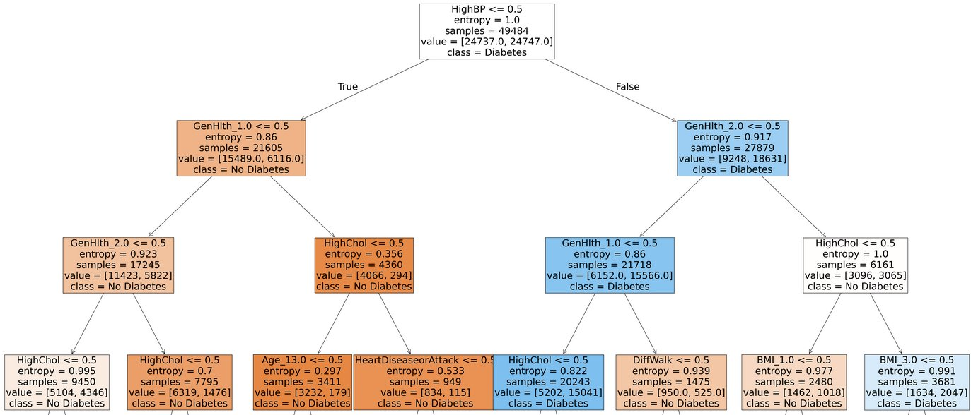
Model Overview – Decision Tree C-5.0

Slide 22
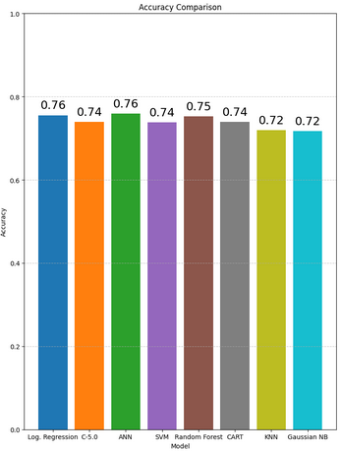
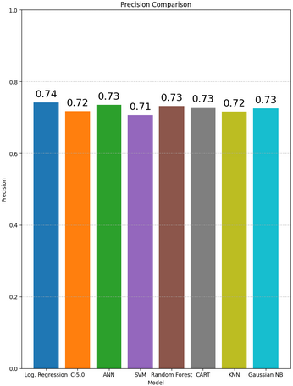
Comparison & Conclusions – Accuracy and Precision (1 of 3)

Slide 23
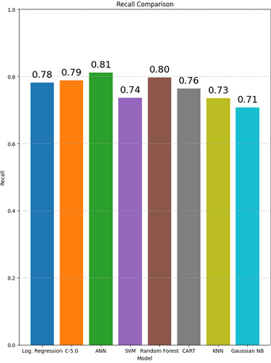
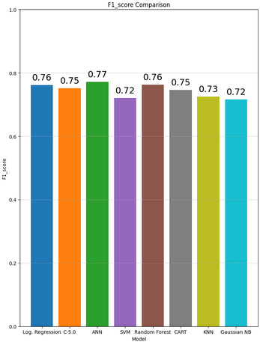
Comparison & Conclusions - Recall and F1 Score (2 of 3)

Slide 24
Comparison & Conclusions (3 of 3)
K-means (Un-supervised algorithm) is not a great clustering algorithm due to overlap present within data grouping.
Both Logistic Regression and ANN (2 hidden layer) models performs relatively similar in terms of accuracy (~0.76 ), followed by Random Forest model (~0.75).
The ANN model has the highest recall (~0.811), which indicates it is most successful at identifying true positive cases of diabetes. This is followed by random forest (~0.79) and C50 decision tree (~0.788). Models like SVM (~0.736) and KNN (~0.735) show relatively lower recall.
Logistic Regression has the highest precision (~0.74) and also performs strongly in terms of F1-score (~0.76). However, the ANN model, with a slightly lower precision (~0.73), still maintains a solid F1-score (~0.77). The C50 decision tree model shows slightly weaker precision (~0.718) but performs reasonably well on F1-score (~0.75).

Slide 25
Future Work
Hyper Parameter Tuning,
Model Deployment in Cloud/POC on Streamlit
Use the latest surveyed data,
Use the other supported datasets,
Implement advanced clustering algorithms,

Slide 26
References
https://www.kaggle.com/code/haidar14/ml-diabetesdatasetclustering
https://www.kaggle.com/datasets/alexteboul/diabetes-health-indicators-dataset/data
Diabetes Prediction Using Random Forest (Random Forest for Diabetes Classification) https://www.sciencedirect.com/science/article/abs/pii/S1877050919302763
A Hybrid Model of CART and Genetic Algorithm for Diabetes Diagnosis ( CART (Classification and Regression Trees) for Diabetes Classification) Link: https://journals.sagepub.com/doi/full/10.1177/2158244013490703
Application of Decision Tree Classifier in Prediction of Diabetes (Decision Tree Classifier for Diabetes Classification) https://pubmed.ncbi.nlm.nih.gov/28714436/
Application of Artificial Neural Networks for Diabetes Classification: A Review (Artificial Neural Network (ANN) for Diabetes Classification) https://www.ncbi.nlm.nih.gov/pmc/articles/PMC4211254/
Predicting Diabetes Using XGBoost Model (XGBoost for Diabetes Classification) https://www.sciencedirect.com/science/article/pii/S2352914819302171
A SVM-based Diabetes Prediction Model Using Ensemble Classifiers (Support Vector Machines (SVM) for Diabetes Classification) https://pubmed.ncbi.nlm.nih.gov/32714468/
K-means Clustering with Random Forest Classifier for Diabetes Diagnosis (K-means Clustering for Diabetes Classification) https://www.sciencedirect.com/science/article/pii/S2352914819303062
K-Nearest Neighbors Classifier for Early Diabetes Detection (K-Nearest Neighbors (KNN) for Diabetes Classification) https://www.hindawi.com/journals/jchem/2020/6535434/
Diabetes Prediction Using Naive Bayes and Logistic Regression (Multinomial Naive Bayes for Diabetes Classification) https://www.hindawi.com/journals/complexity/2021/6647793/
Adult BMI Categories https://www.cdc.gov/bmi/adult-calculator/bmi-categories.html

Slide 28


Questions?

Slide 29
Data Fields
AnyHealthcare | Have any king of healthcare coverage 0 = No 1 = Yes
NoDocbcCost | Any time in past 12 months needed a doctor but could not go because of cost? 0 = No 1 = Yes
GenHlth | Would you say that in general your health is: 1 = Excellent 2 = Very Good 3 = Good 4 = Fair 5 = Poor
MentHlth | Days of Poor Mental Health 1-30 days
PhysHlth | Physical Illness or Injury In Past 30 days 1-30 days
DiffWalk | Have serious difficulty walking or climbing stairs 0 = No 1 = Yes
Sex | 0 = Female 1 = Male
Age | Scale 1-13 1 = 18-24 Increments every 5 years 13 = 80+
Education | Highest Grade or Year of School Completed 1 = Never Attended / Only Kindergarten 2 = Elementary 3 = Some Highschool 4 = Graduated Highschool 5 = Some College 6 = Graduated College
Income | Scale 1-8 Increment every $5k 1 = less than $10,000 5 = $20,000 - $35,000 8 = $75,000+
Diabetes_binary | 0 = No Diabetes 1 = Prediabtes & diabetes
HighBP | 0 = No High Blood Pressure 1 = High Blood Pressure
HighChol | 0 = No High Cholesterol 1 = High Cholesterol
CholCheck | 0 = No Cholesterol Check in 5 years 1 = Yes Cholesterol Check in 5 years
BMI | Body Mass Index
Smoker | Have smoked 100 cigarettes in entire life? 0 = No 1 = Yes
Stroke | Ever Told You Had a Stroke? 0 = No 1 = Yes
HeartDiseaseorAttack | 0 = No 1 = Yes
PhysActivity | Physical Activity in Past 30 Days (not including job) 0 = No 1 = Yes
Fruits | Consumed Fruit 1 or More Times Per Day 0 = No 1 = Yes
Veggies | Consumed Vegetables 1 or More Times Per Day 0 = No 1 = Yes
HvyAlcoholConsump | Adult Men >= 14 drinks per week Adult Women >= 7 drinks per week 0 = No 1 = Yes
Notes:
Aryan

